Slide 1
ECE 331 – Digital System Design
Counters
(Lecture #19)
The slides included herein were taken from the materials accompanying
Fundamentals of Logic Design, 6th Edition, by Roth and Kinney,
and were used with permission from Cengage Learning.

Slide 2
Material to be covered …
Chapter 12: Sections 3 – 6
Fall 2010
ECE 331 - Digital System Design

Slide 3
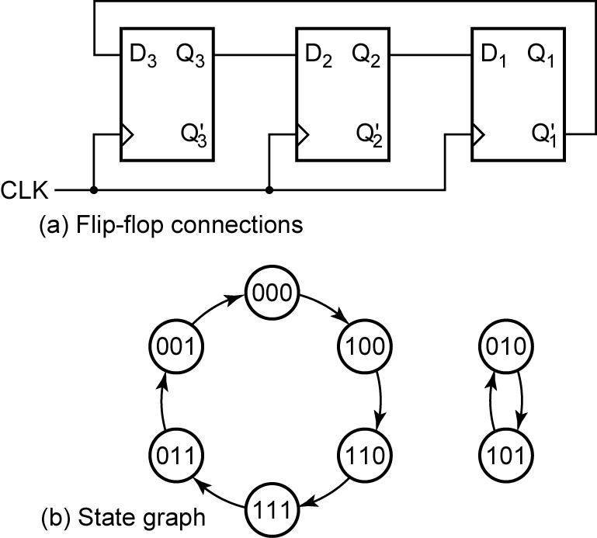
Counters
Shift register with
inverted feedback
A circuit that cycles through a fixed sequence of states is called a counter.
Fall 2010
ECE 331 - Digital System Design

Slide 4
Binary Counters
000
111
001
110
010
101
011
100
3-bit Binary Counter
Fall 2010
ECE 331 - Digital System Design

Slide 5
Binary Counters: Design
Create a state graph to count in the desired sequence.
Create a state table from the state graph created in (1). We need one flip-flop per bit.
Derive Karnaugh maps from the state table created in (2) and solve for the inputs to each flip-flop.
Fall 2010
ECE 331 - Digital System Design

Slide 6
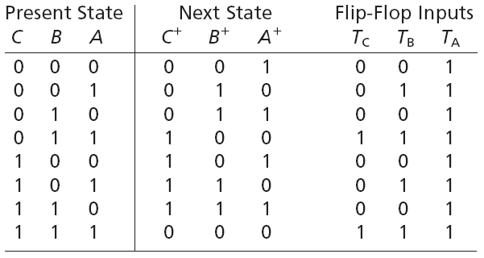
Binary Counter
Example: State Table (using T FF)
Fall 2010
ECE 331 - Digital System Design

Slide 7
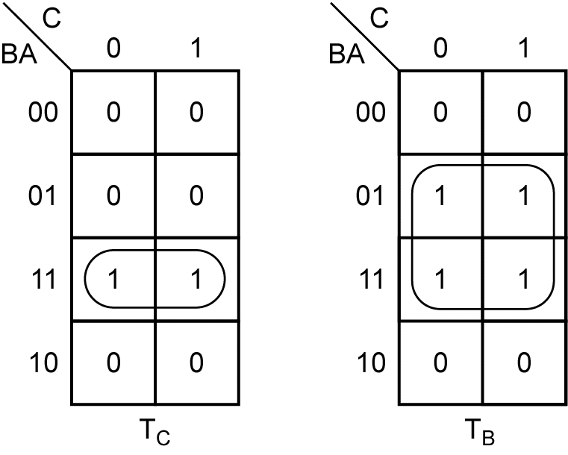
Binary Counter
Example: K-maps (for T FF)
Fall 2010
ECE 331 - Digital System Design

Slide 8
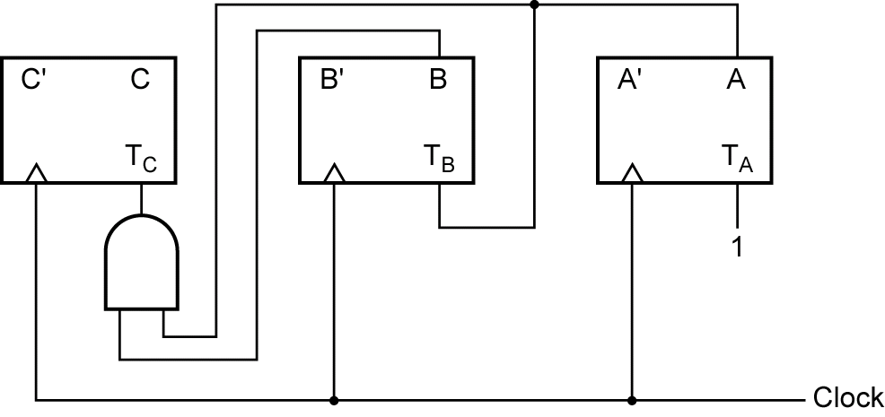
Binary Counter
Example: Circuit Diagram (using T FF)
Fall 2010
ECE 331 - Digital System Design

Slide 9
Binary Counter
Example: State Table (using D FF)
Fall 2010
ECE 331 - Digital System Design

Slide 10
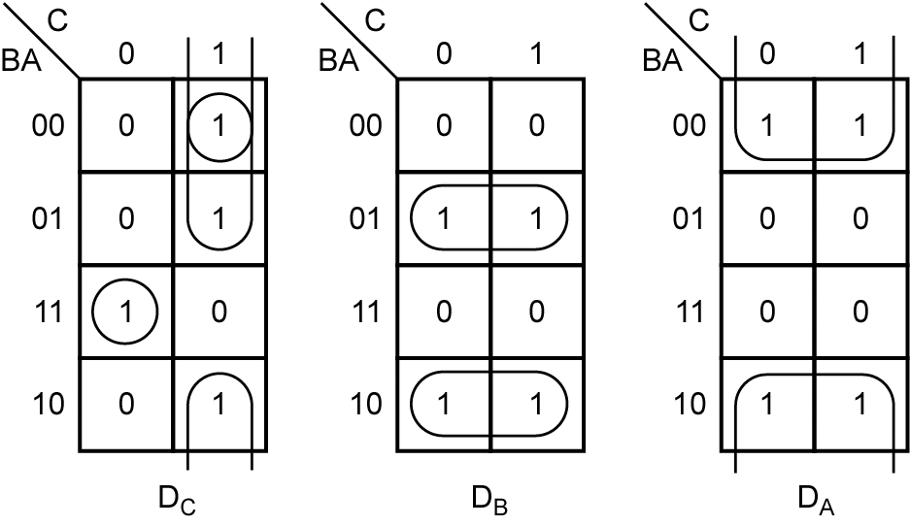
Binary Counter
Example: K-maps (for D FF)
Fall 2010
ECE 331 - Digital System Design

Slide 11
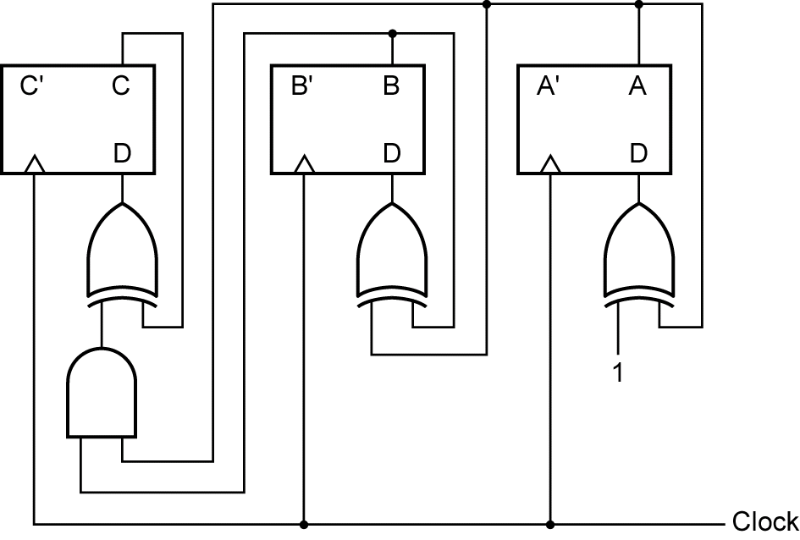
Binary Counter
Example: Circuit Diagram (using D FF)
Fall 2010
ECE 331 - Digital System Design

Slide 12
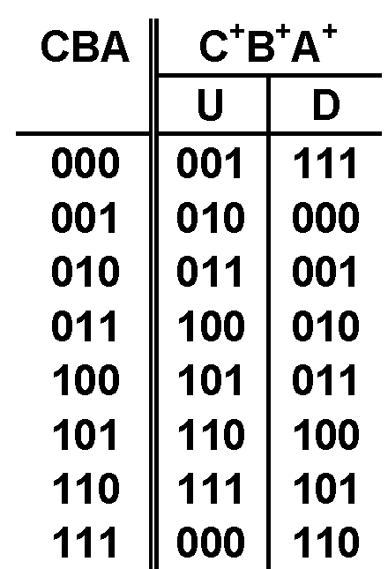
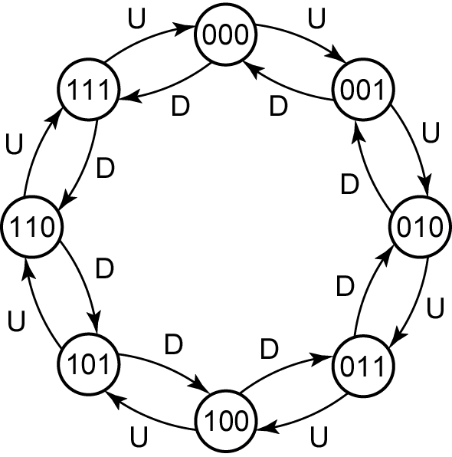
Binary Up-Down Counter
Fall 2010
ECE 331 - Digital System Design

Slide 13
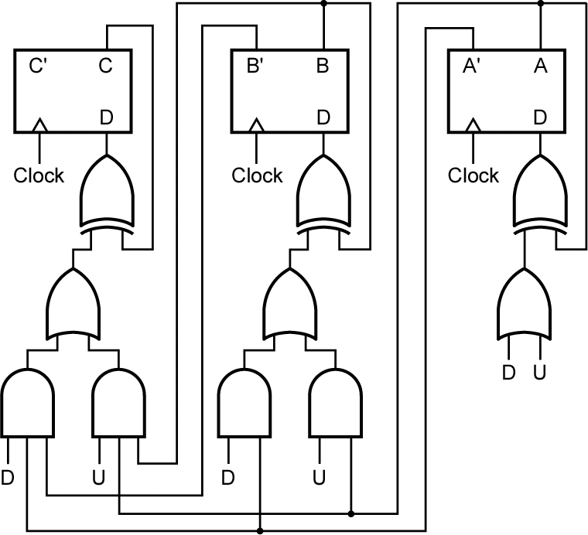
Binary Up-Down Counter
Fall 2010
ECE 331 - Digital System Design

Slide 14
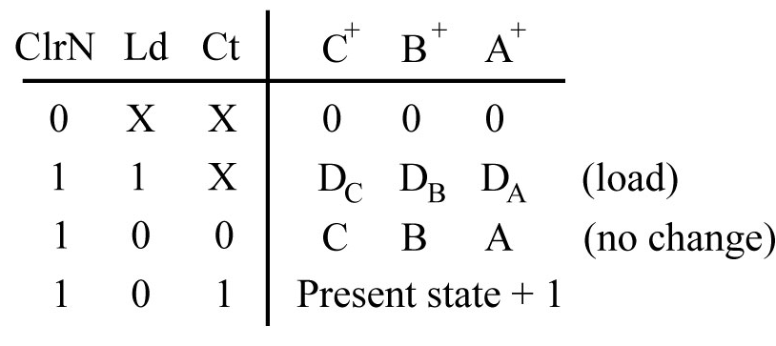
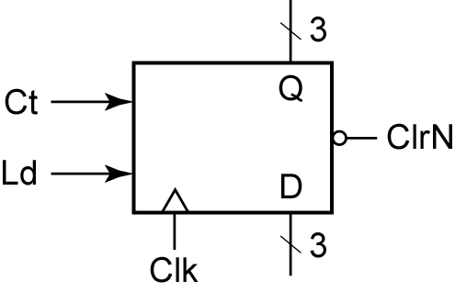
Loadable Counter with Enable
Fall 2010
ECE 331 - Digital System Design

Slide 15
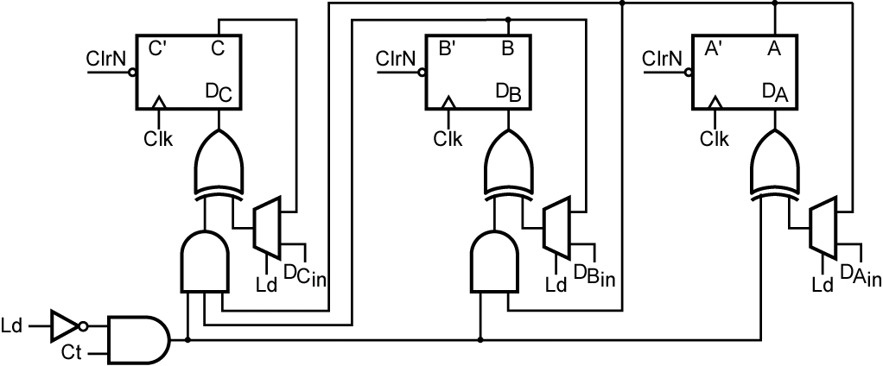
Loadable Counter with Enable
Fall 2010
ECE 331 - Digital System Design

Slide 16
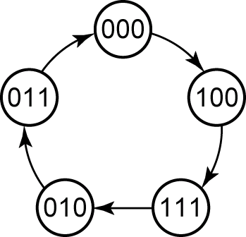
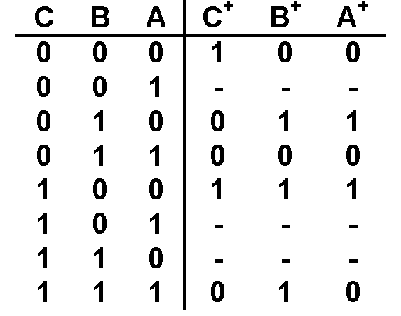
Counter Design (T FF)
Example: 000 → 100 → 111 → 010 → 011
Fall 2010
ECE 331 - Digital System Design

Slide 17
Counter Design (T FF)
Example: 000 → 100 → 111 → 010 → 011
We could derive T_{C} , T_{B} , and T_{A} directly from the state table, but it is often more convenient to plot next-state maps showing C⁺, B⁺, and A⁺ as functions of C, B, and A, and then derive T_{C} , T_{B} , and T_{A} from these maps.
Fall 2010
ECE 331 - Digital System Design

Slide 18
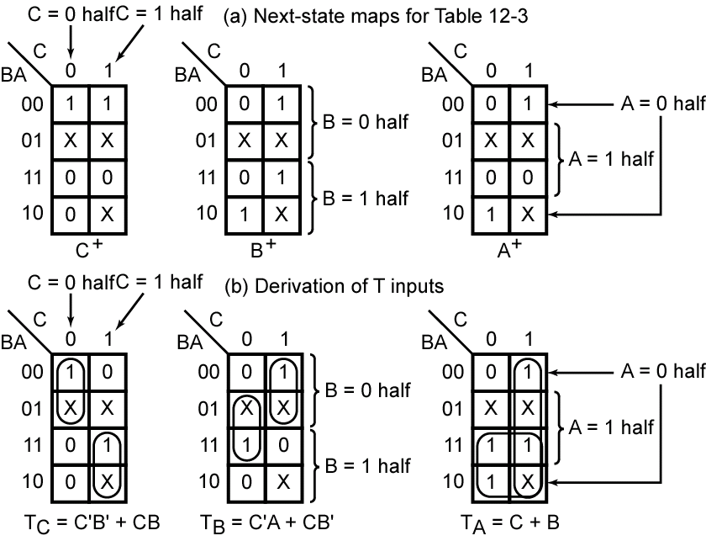
Counter Design (T FF)
Example: 000 → 100 → 111 → 010 → 011
Fall 2010
ECE 331 - Digital System Design

Slide 19
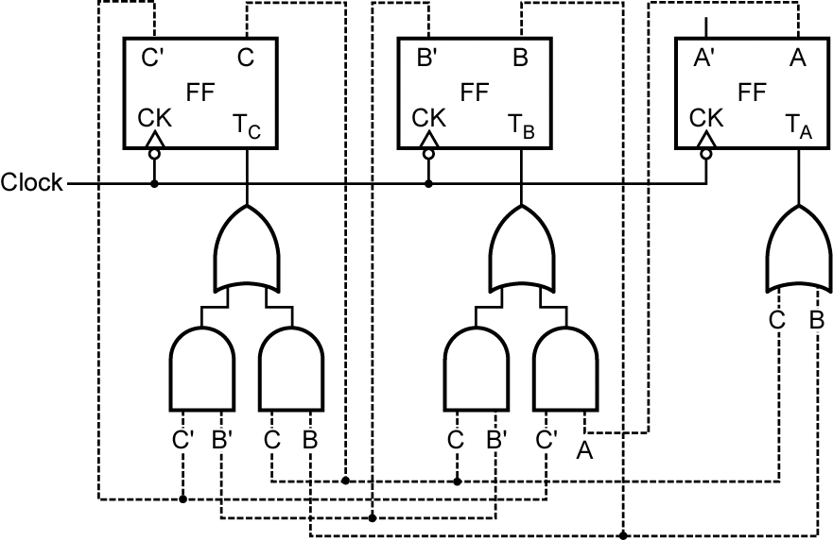
Counter Design (T FF)
Example: 000 → 100 → 111 → 010 → 011
Fall 2010
ECE 331 - Digital System Design

Slide 20
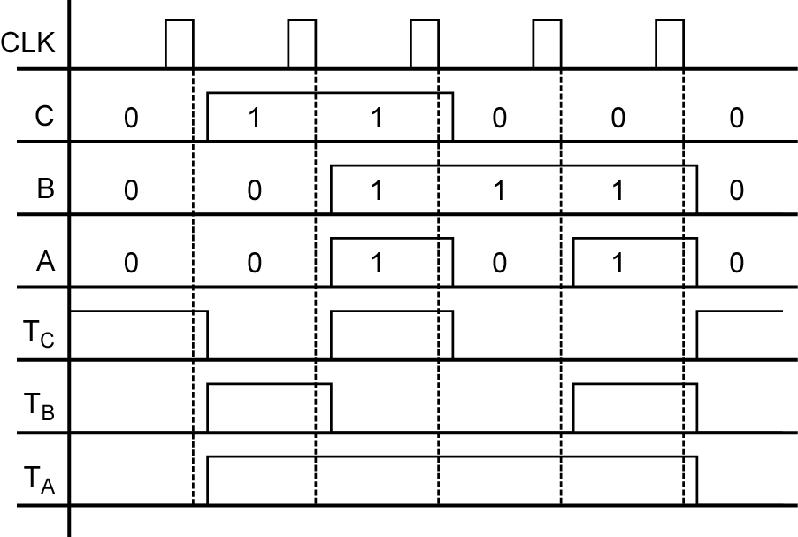
Counter Design (T FF)
Example: 000 → 100 → 111 → 010 → 011
Fall 2010
ECE 331 - Digital System Design

Slide 21
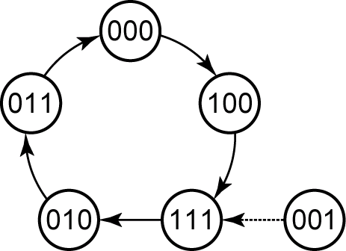
Counter Design (T FF)
Example: 000 → 100 → 111 → 010 → 011
Although the original state table for the counter is not completely specified, the next states of states 001, 101, and 110 have been specified in the process of completing the circuit design
Fall 2010
ECE 331 - Digital System Design

Slide 22
Counter Design (T FF)
Example: 000 → 100 → 111 → 010 → 011
Given the present state of a T flip-flop (Q) and the desired next state (Q⁺), the T input must be a 1 whenever a change in state is required. Thus, T = 1 whenever Q⁺ ≠ Q.
Excitation Table
Q⁺ | Q | T
0 | 0 | 0
0 | 1 | 1
1 | 0 | 1
1 | 1 | 0
T = Q⁺ xor Q
Fall 2010
ECE 331 - Digital System Design

Slide 23
Counter Design (D FF)
Example: 000 → 100 → 111 → 010 → 011
Fall 2010
ECE 331 - Digital System Design

Slide 24
Counter Design (D FF)
Example: 000 → 100 → 111 → 010 → 011
Characteristic Equation: Q⁺ = D
Fall 2010
ECE 331 - Digital System Design

Slide 25
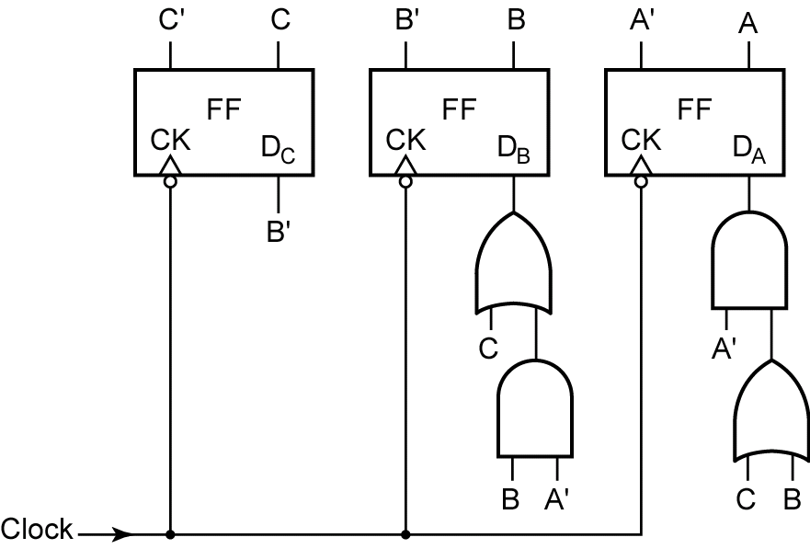
Counter Design (D FF)
Example: 000 → 100 → 111 → 010 → 011
Fall 2010
ECE 331 - Digital System Design

Slide 26
Counter Design (D FF)
Example: 000 → 100 → 111 → 010 → 011
Although the original state table for the counter is not completely specified, the next states of states 001, 101, and 110 have been specified in the process of completing the circuit design
Fall 2010
ECE 331 - Digital System Design

Slide 27
Counter Design (SR FF)
Example: 000 → 100 → 111 → 010 → 011
The procedures used to design a counter with S-R flip-flops are similar to the procedures for T flip-flops. However, instead of deriving an input equation for each D or T flip-flop, the S and R input equations must be derived for each S-R flip-flop.
Fall 2010
ECE 331 - Digital System Design

Slide 28
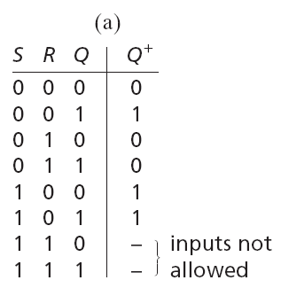
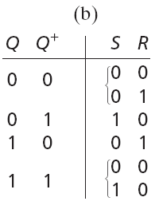
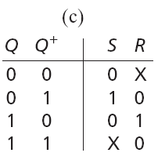
Counter Design (SR FF)
Example: 000 → 100 → 111 → 010 → 011
Excitation Table
Fall 2010
ECE 331 - Digital System Design

Slide 29
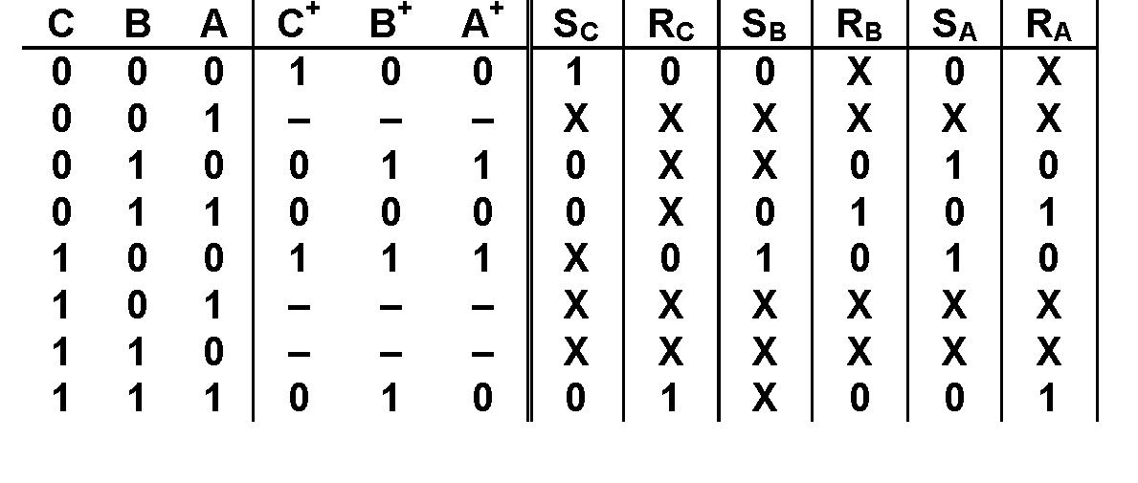
Counter Design (SR FF)
Example: 000 → 100 → 111 → 010 → 011
Fall 2010
ECE 331 - Digital System Design

Slide 30
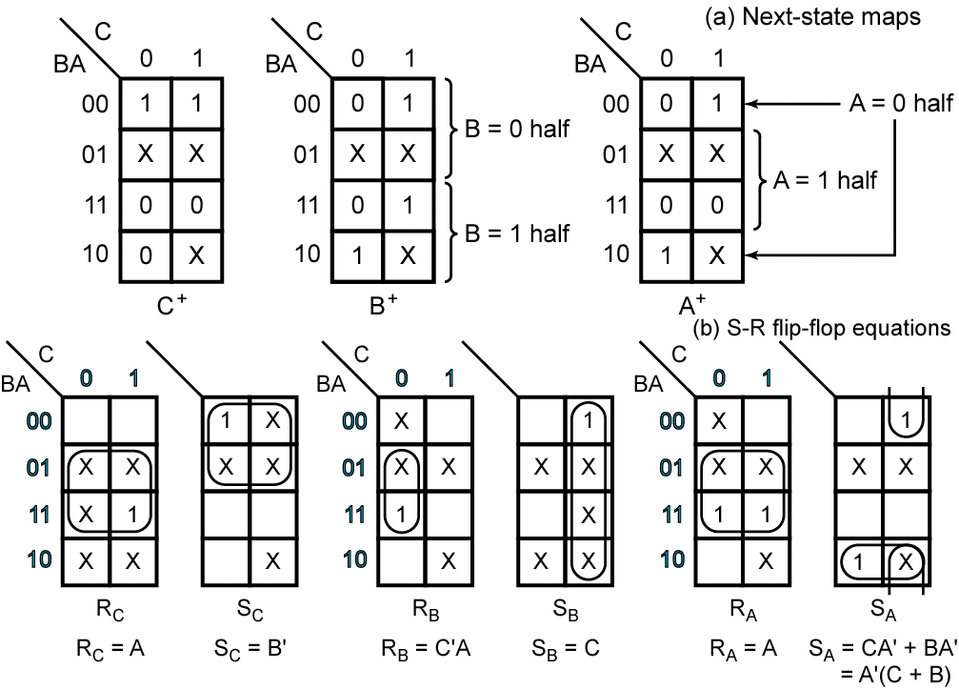
Counter Design (SR FF)
Example: 000 → 100 → 111 → 010 → 011
Fall 2010
ECE 331 - Digital System Design

Slide 31
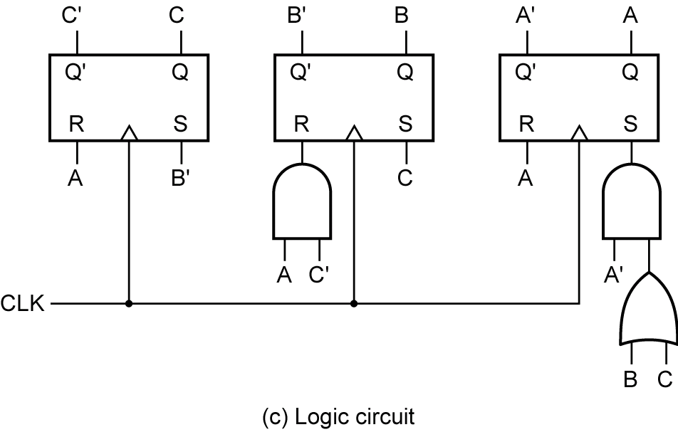
Counter Design (SR FF)
Example: 000 → 100 → 111 → 010 → 011
Fall 2010
ECE 331 - Digital System Design

Slide 32
Counter Design (JK FF)
Example: 000 → 100 → 111 → 010 → 011
The procedures used to design a counter with JK flip-flops are similar to the procedures for T flip-flops. However, instead of deriving an input equation for each D or T flip-flop, the J and K input equations must be derived for each JK flip-flop.
Fall 2010
ECE 331 - Digital System Design

Slide 33
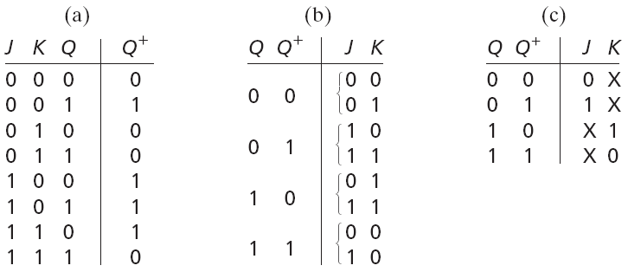
Counter Design (JK FF)
Example: 000 → 100 → 111 → 010 → 011
Excitation Table
Fall 2010
ECE 331 - Digital System Design

Slide 34
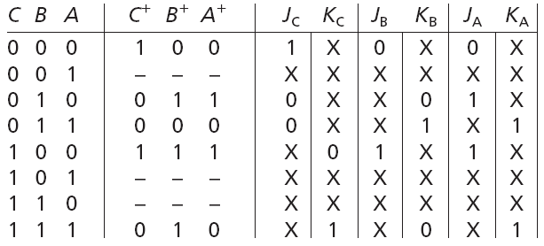
Counter Design (JK FF)
Example: 000 → 100 → 111 → 010 → 011
Fall 2010
ECE 331 - Digital System Design

Slide 35
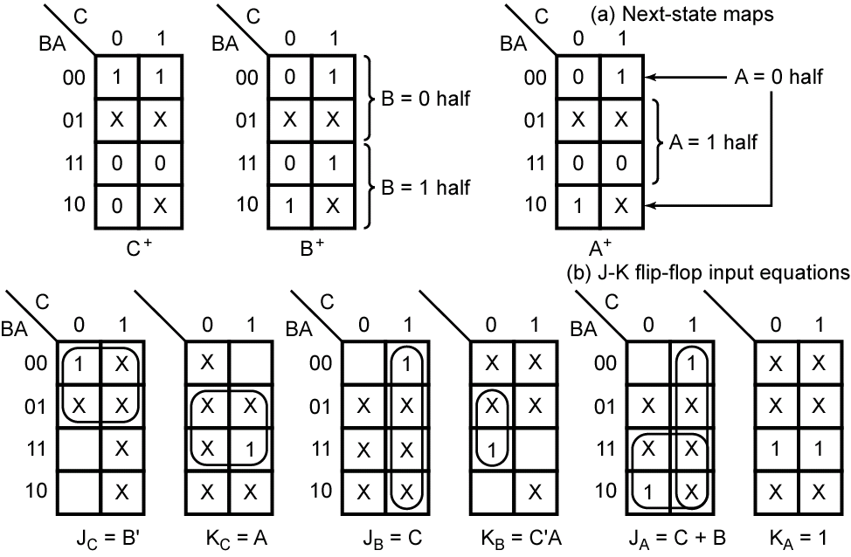
Counter Design (JK FF)
Example: 000 → 100 → 111 → 010 → 011
Fall 2010
ECE 331 - Digital System Design

Slide 36
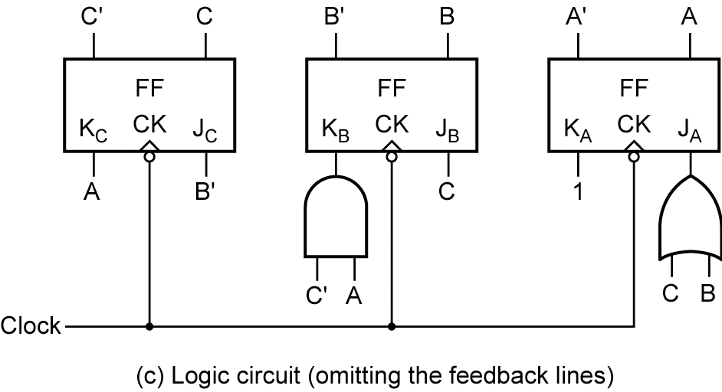
Counter Design (JK FF)
Example: 000 → 100 → 111 → 010 → 011
Fall 2010
ECE 331 - Digital System Design

Slide 37
Questions?
Fall 2010
ECE 331 - Digital System Design

